Slide 1
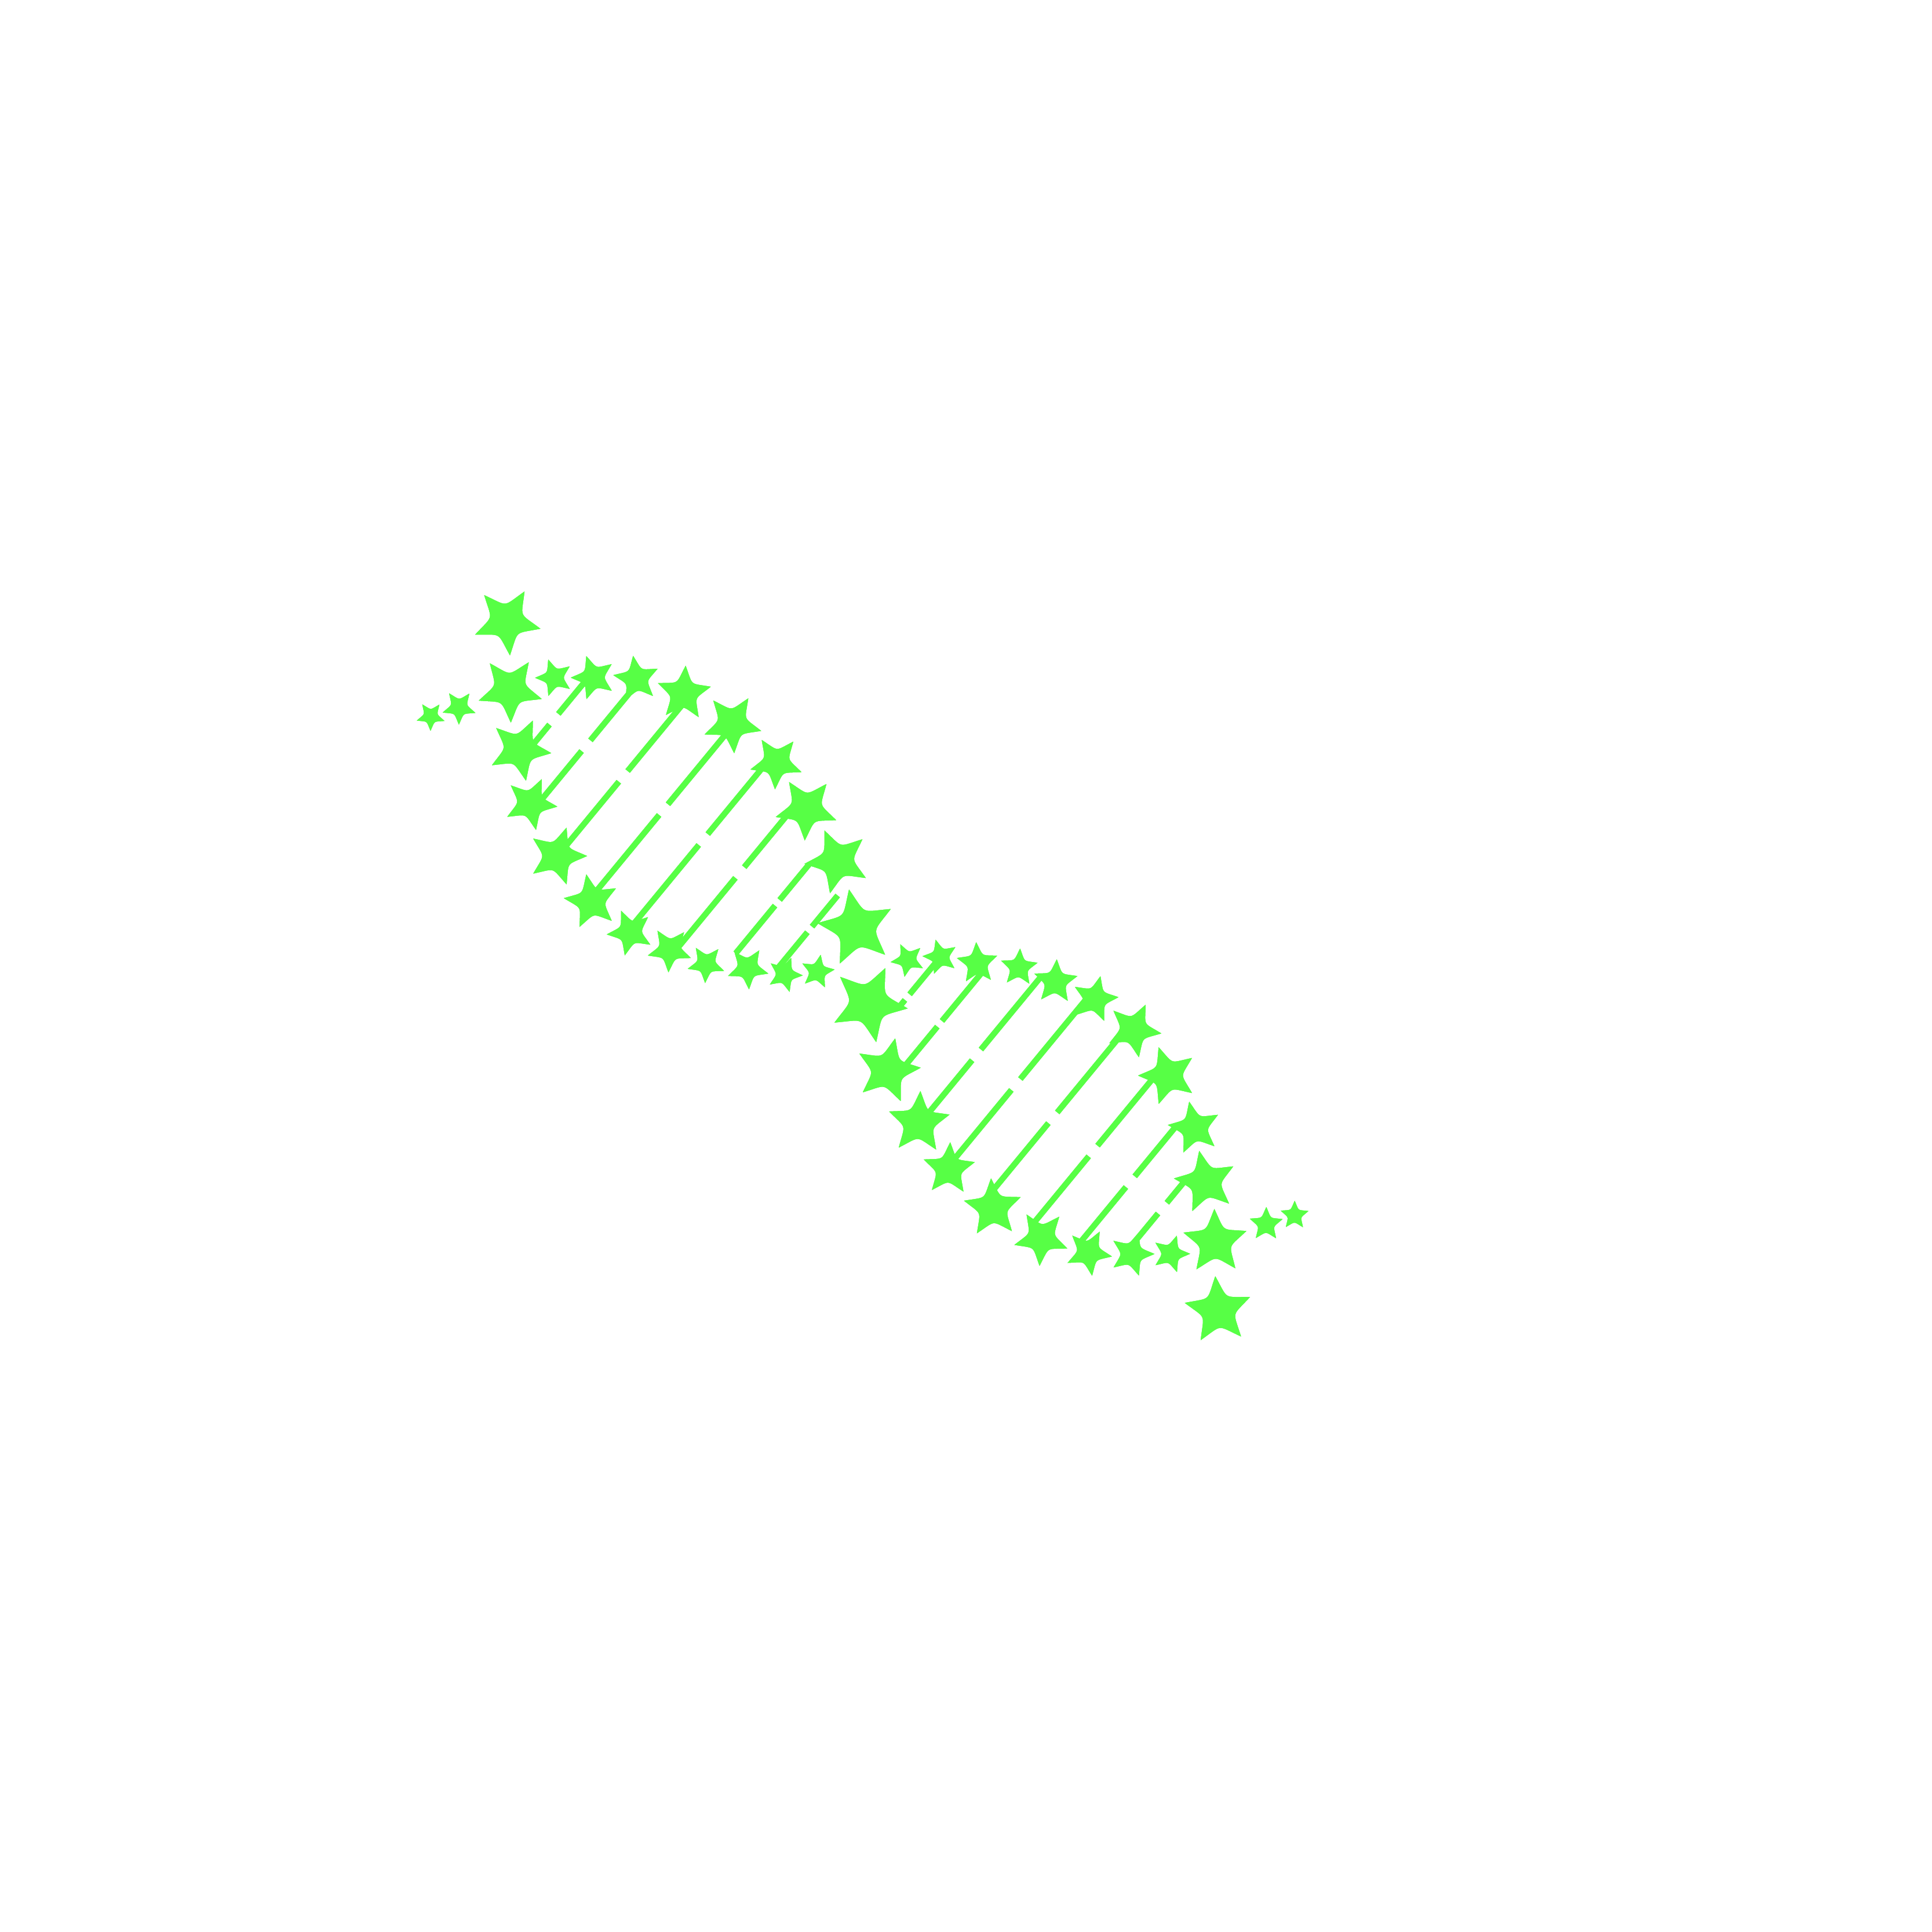
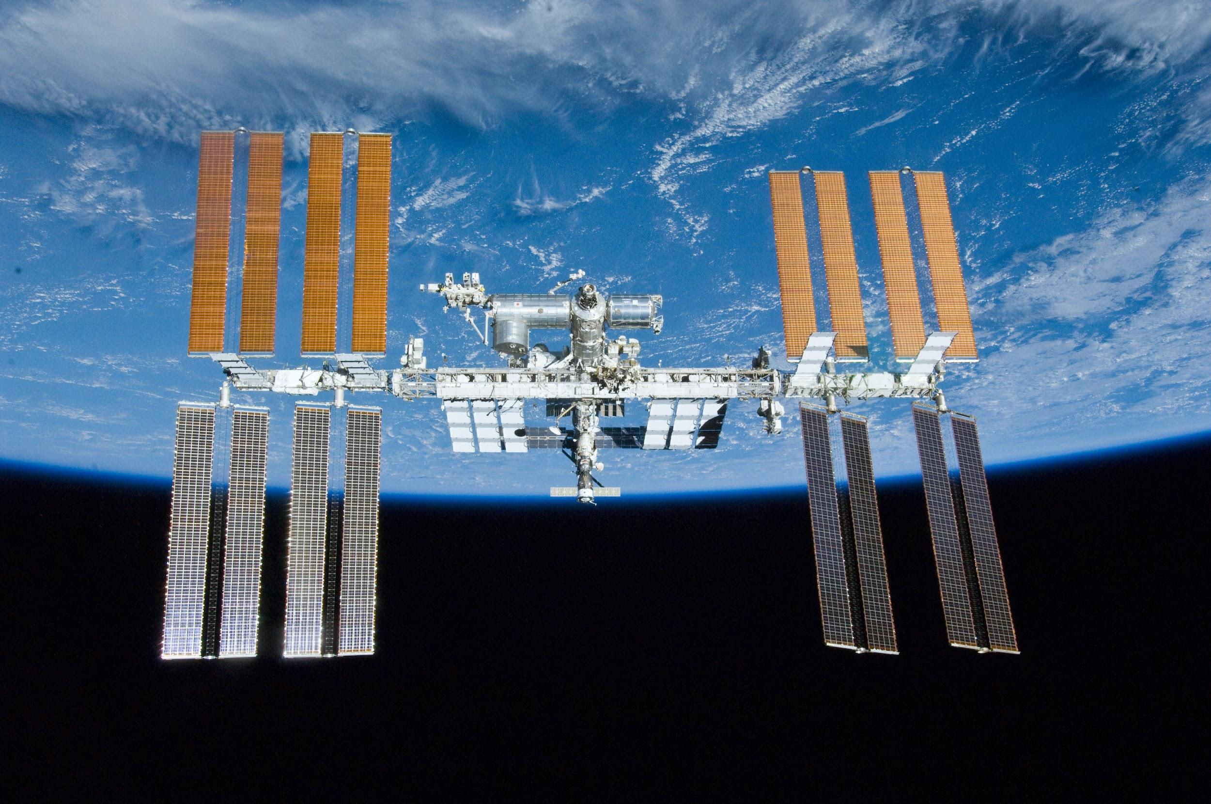
Genes in Space
2023
GENES IN SPACE
2023

Slide 2
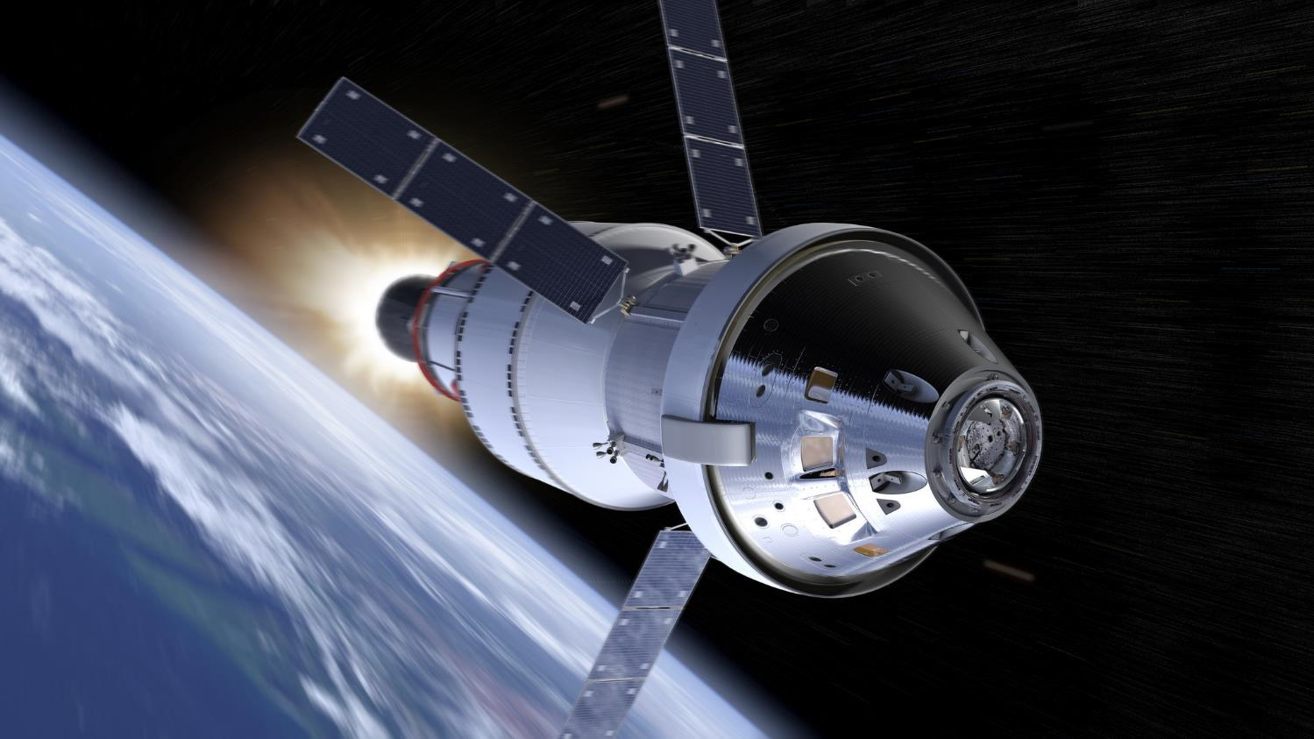
A new era in space exploration
Notes:
Right now NASA and space programs around the world are preparing for the next manned missions beyond earth – to the moon, Mars, and beyond

Slide 3
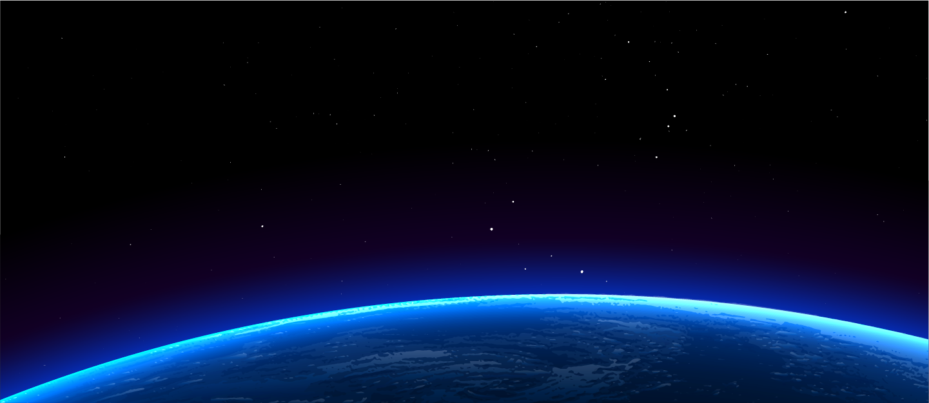





What space biology mystery will you solve?
Can we use the Genes in Space toolkit to detect new life forms?
What microorganisms do astronauts share space with?
What’s the most creative, relevant, and bold question you can ask?
Do molecules behave differently in space than they do on Earth?
Are there adaptations that help organisms dwell in microgravity?
Notes:
However, many questions remain about how the human body and the organisms we bring to space with us – either intentionally as food or unintentionally like our microbiome – will respond to months or even years exposed to microgravity, cosmic radiation, and other environmental conditions in space

Slide 4
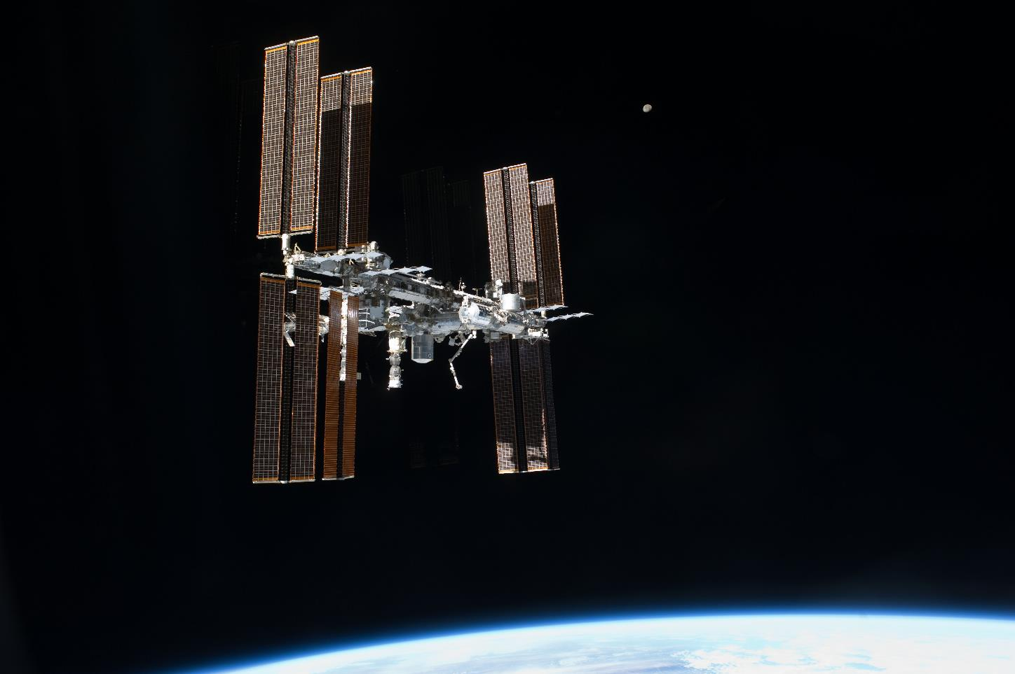
The grand prize:
YOUR experiment on the International Space Station (ISS)!
Notes:
Currently the ISS serves as a place where we can begin to answer some of these questions:
World’s only microgravity facility
Test bed for deep space exploration
Continuous human presence in space since 2001
Can be seen with the naked eye - https://spotthestation.nasa.gov/
http://www.spacestationexplorers.org/explore/iss/ and http://www.spacestationexplorers.org/explore/iss/life/

Slide 5
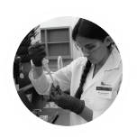

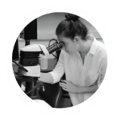
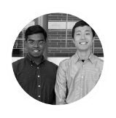
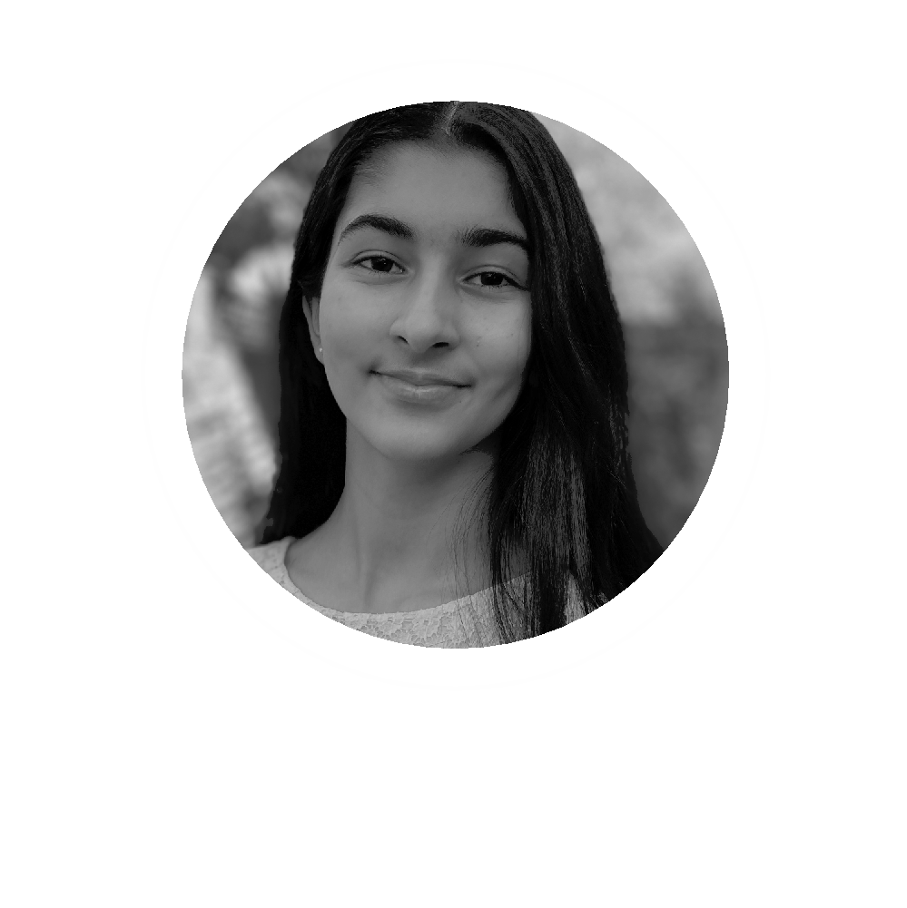














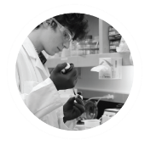
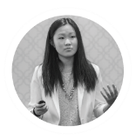
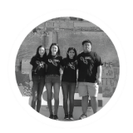
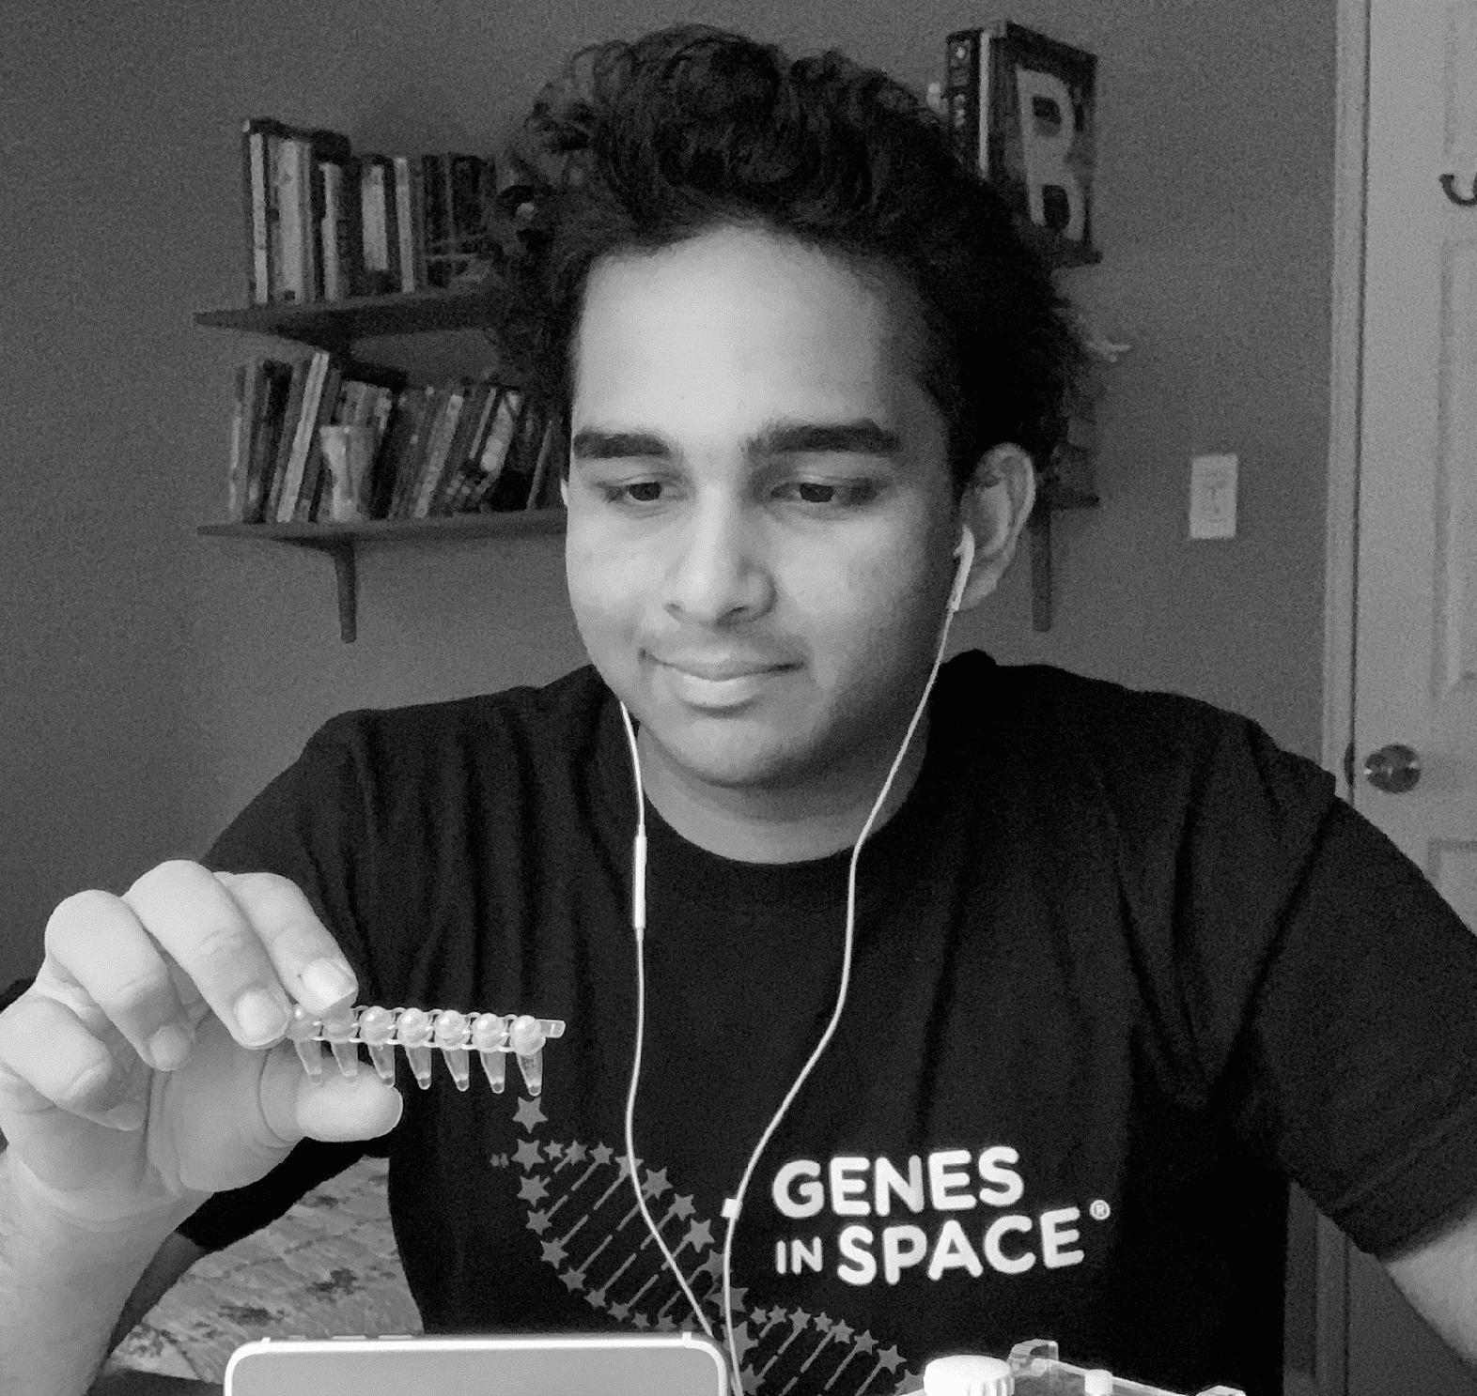

ANNA-SOPHIA BOGURAEV
ALIA AL MANSOORI
LIZA REIZIS
FINSAM SAMSON
& YUJIE WANG
SELIN KOCALAR
Topic: Regulation of
Immune function
Topic: Immune cell development
Topic: Regulation of cell death
Topic: Circadian function
Topic: Monitoring water quality
JULIAN RUBINFIEN
SOPHIA CHEN
DAVID LI, REBECCA LI, MICHELLE
SUNG & AARTHI VIJAYAKUMAR
KRISTOFF MISQUITTA
PRISTINE ONUOHA
Topic: Accelerated aging
Topic: Genome stability
Topic: DNA repair
Topic: Drug metabolism
Topic: Basis of telomere lengthening
Notes:
Winning proposals span all areas of biology

Slide 6
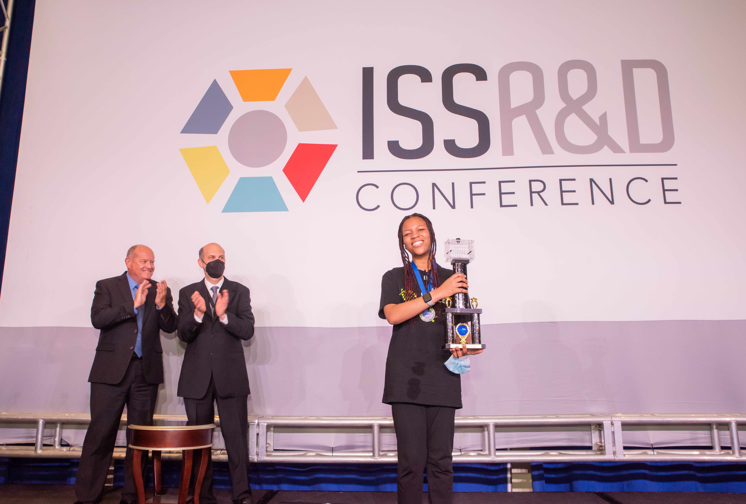
YOU can be the next space biology pioneer
Notes:
Genes in Space challenges middle and high school students to contribute to this growing space research field by proposing a DNA experiment for space. This photo features 2022 contest winner Pristine Onuoha from Chapel Hill, NC, who proposed an experiment that investigates the basis of telomere lengthening observed in astronauts. Her experiment will launch to the ISS in 2023.

Slide 7
Applying is easy
Identify an open question
Formulate a hypothesis
Experimental plan: Use the Genes in Space toolkit
Justify your use of the ISS
?
Notes:
Challenges – study the effects of cosmic conditions on humans and organisms we bring with us to space, develop ways to keep people healthy in space, bioengineer plants and other organisms to thrive in space conditions, etc.
Opportunities – can we do things in space that we cannot do on earth (ex develop new biotech or medicines, study natural selection in a new environment, discover alien life)?

Slide 8

Applying is easy
Identify an open question
Formulate a hypothesis
Experimental plan: Use the Genes in Space toolkit
Justify your use of the ISS

Slide 9
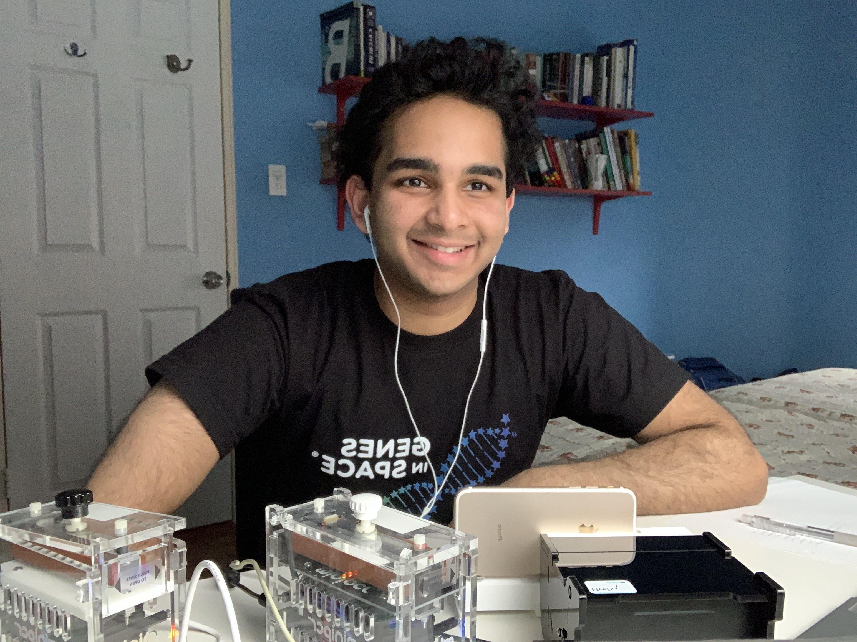
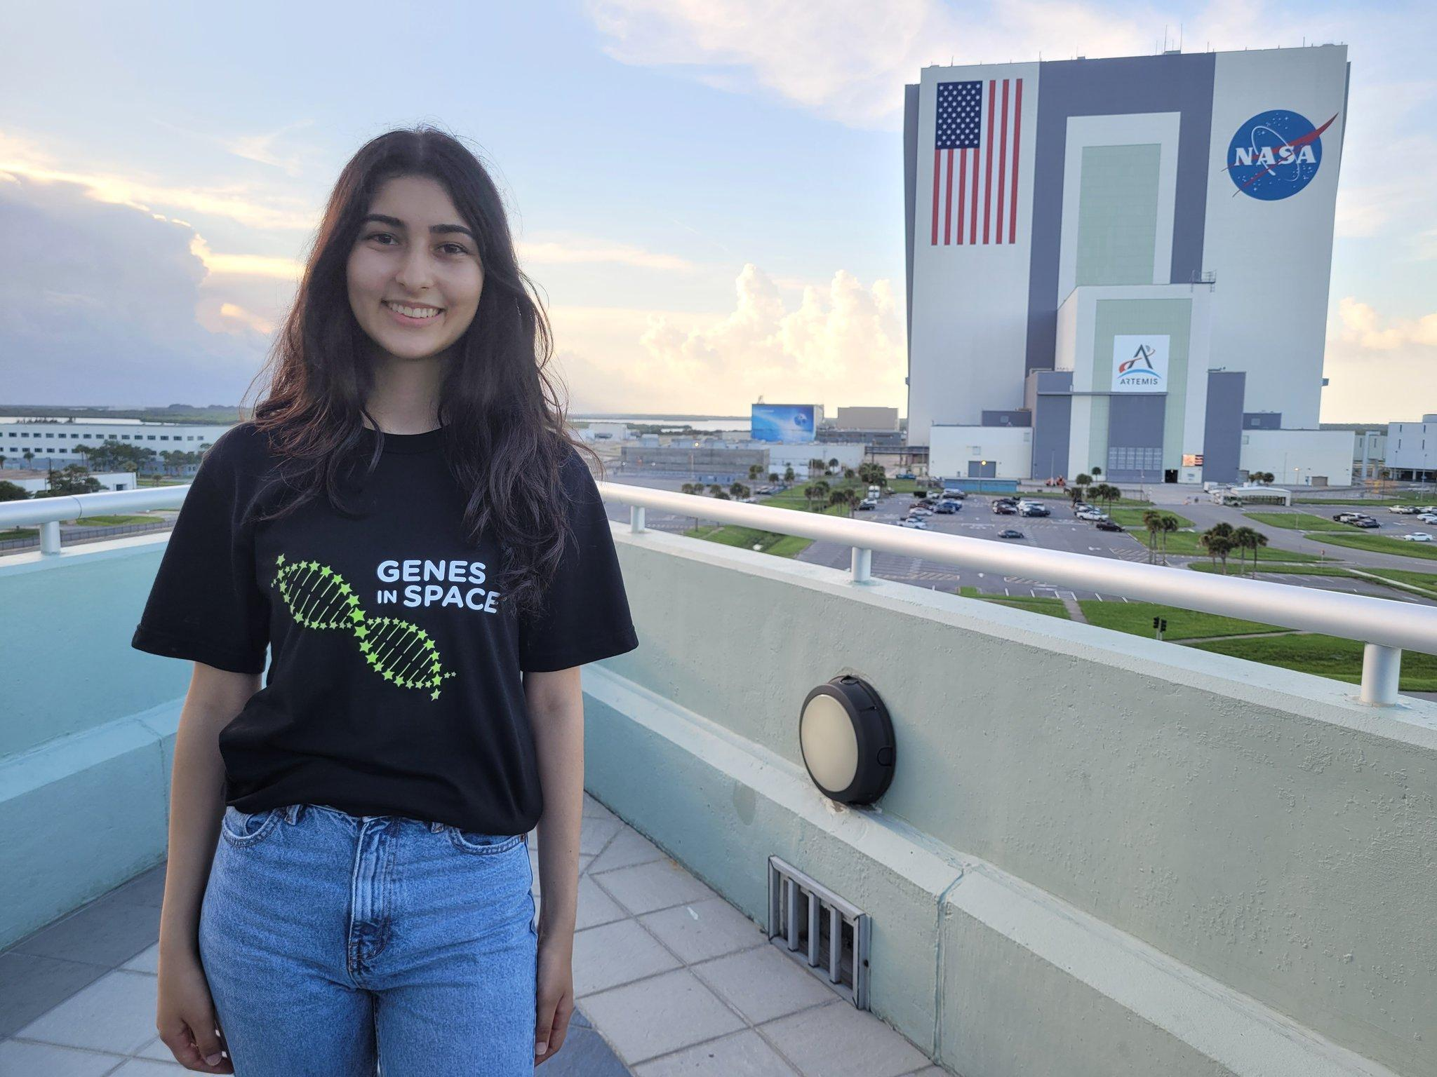
Past winners’ hypotheses
Kristoff Misquitta
(2020)
Hypothesis: Spaceflight alters drug metabolism
Selin Kocalar (2021)
Hypothesis: Cell-free technology can be used to test for water contamination aboard spacecraft
Pristine Onuoha (2022)
Hypothesis: Telomere lengthening observed in astronauts is caused by stem cell proliferation
Notes:
Some examples of Genes in Space winning hypotheses.

Slide 10

Applying is easy
Identify an open question
Formulate a hypothesis
Experimental plan: Use the Genes in Space toolkit
Justify your use of the ISS

Slide 11
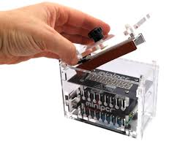

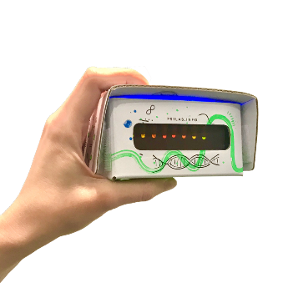
The Genes in Space toolkit
PCR
→ Use it to make copies of a gene you want to study
BioBits cell-free system
→ Use it to manufacture proteins
P51 fluorescence viewer
→ Use it to visualize fluorescent molecules
Notes:
Learn more at www.genesinspace.org/toolkit

Slide 12

Applying is easy
Identify an open question
Formulate a hypothesis
Experimental plan: Use the Genes in Space toolkit
Justify your use of the ISS
Notes:
The International Space Station is an extremely precious resource – even seasoned researchers don’t typically get to carry out experiments on the ISS. For this reason, it is important that students explain why their experiment can only be carried out aboard the ISS. Learn more about the unique environment aboard the ISS at https://www.boeing.com/space/international-space-station/

Slide 13
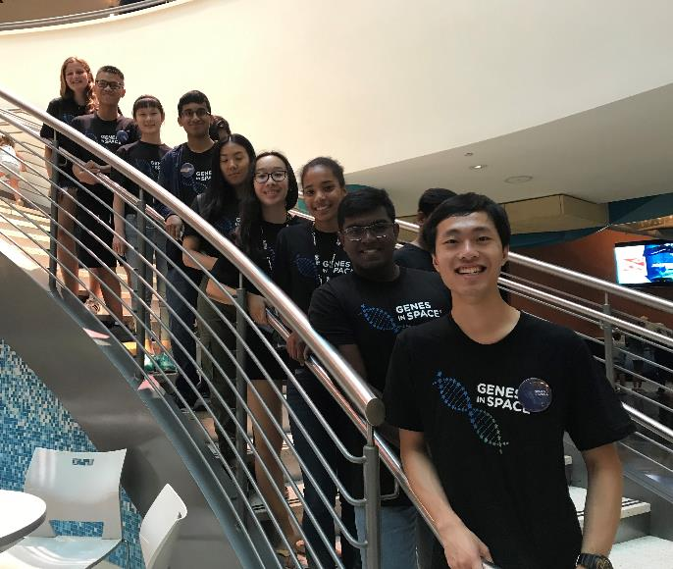
Genes in Space 2023
U.S. students in grades 7-12
Apply individually or in pairs
Application must be sponsored by an adult
Application open January 12 - April 17 at www.genesinspace.org
Cost: FREE
Notes:
Applying to Genes in Space is free and does NOT require you to actually do the experiments. It is an ideas competition. For more details on contest entry, visit genesinspace.org/contest

Slide 14








Contest timeline
Open
January 12, 2023
Develop your idea
Submit by
April 17, 2023
Awardees & semifinalists
May 4, 2023
Finalists
May 22, 2023
Mentoring
June-July
Winner
announced
August 3, 2023
Your experiment in space!
2024

Slide 15
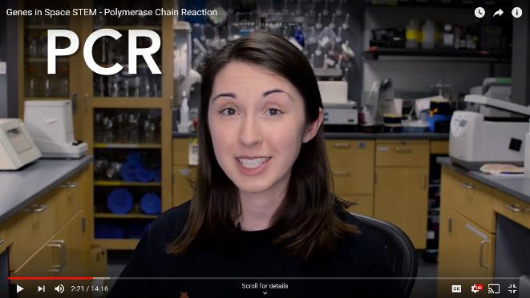
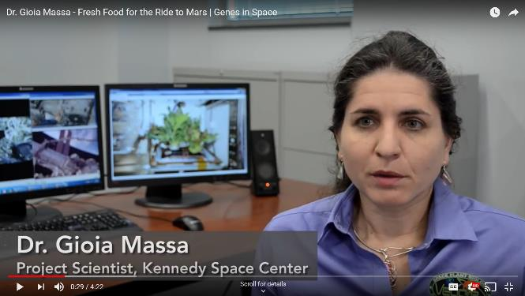
More resources
genesinspace.org/learn
Biotechnology explainers
Space biology research
Publications from past awardees
AND MORE!

Slide 16




